Slide 1

(Very) Quick Look Results
Three HST image triples (619, 631, 645 nm) for cloud pressure and ammonia abundance are ‘analyzed’
Times (2025-10-16) and notable features:
~0015Z – GRS, NEDFs, belts/zones
~0325Z – SED NEDFs
~0500Z – NEDFs
Qualitative analysis and comparison to ground data
Ratio of CH₄ transmission over NH₃ transmission gives qualitative indication NH₃ abundance
Co-alignment of “reg” maps done by hand
COTS software (QFitsView, MaximDL) used

Slide 2
Considerations
Simple ratios of transmission computed
T_{CH4} = R₆₁₉/R₆₃₁, T_{NH3} = R₆₄₅/R₆₃₁
Cloud Pressure ~ 1-T_{CH4}
Ammonia ~ T_{CH4}/T_{NH3}
Possible navigation issues with ground data for Sys 3 long
No accounting for contamination of 645 NH₃ band by 668 CH₄ band
Sensitive to pressures of ~2 bar

Slide 3
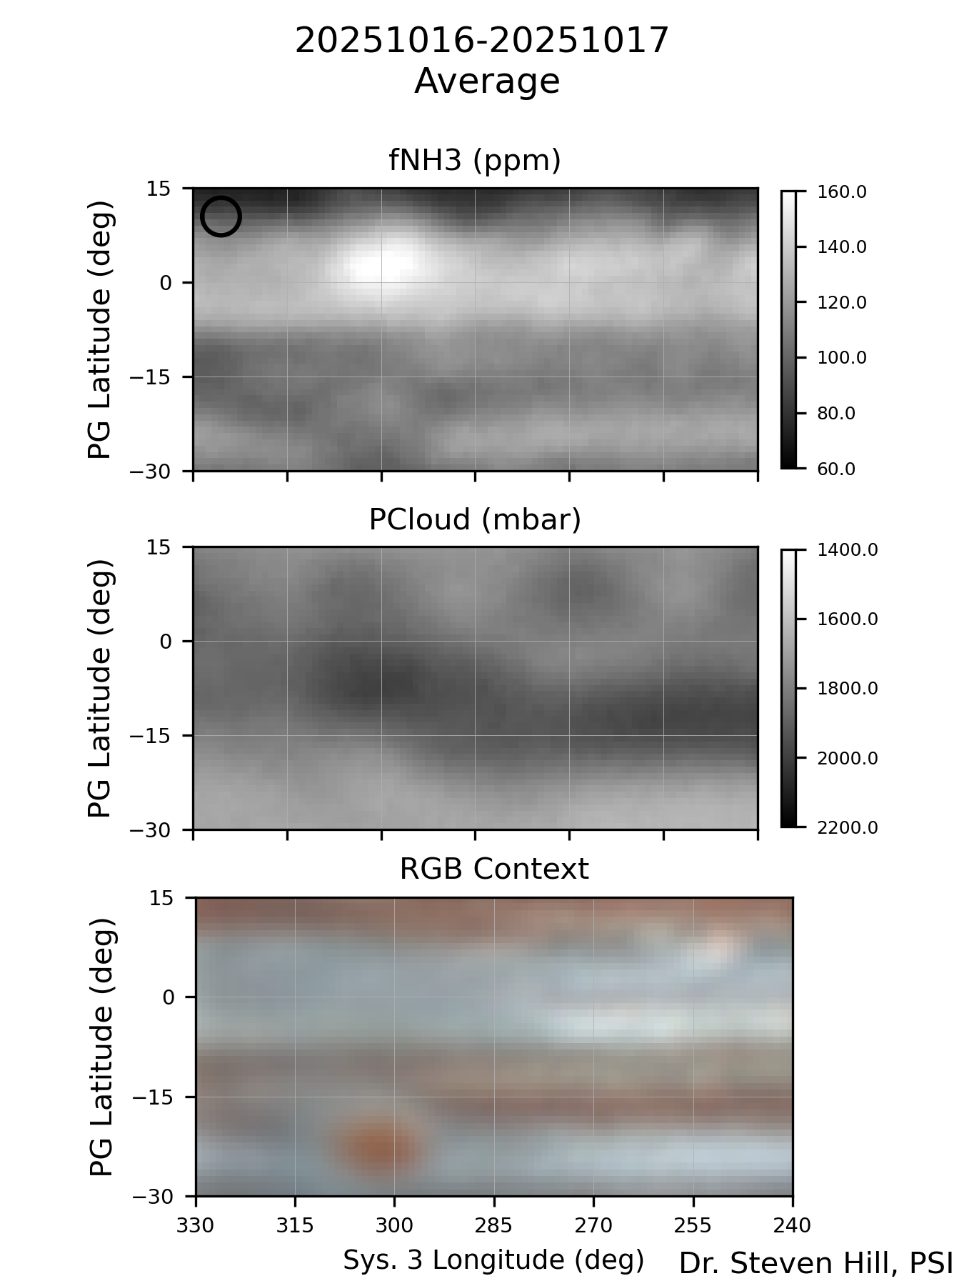
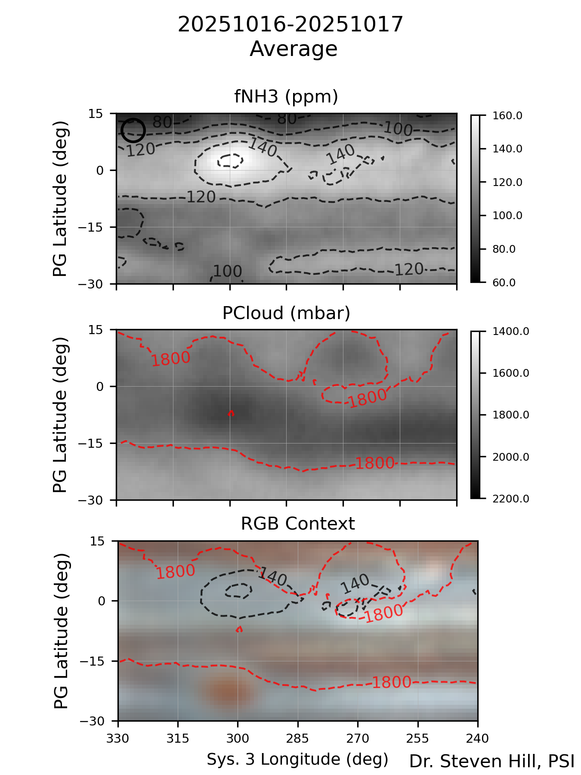
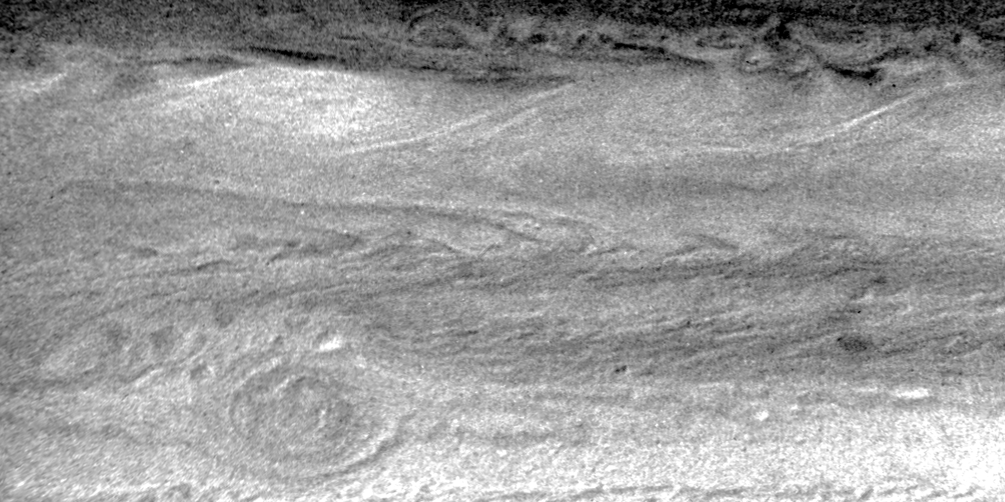
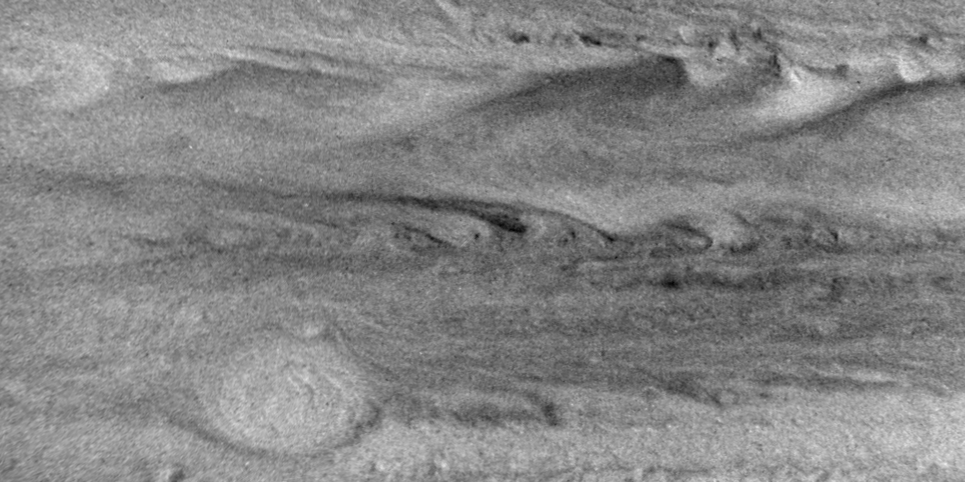
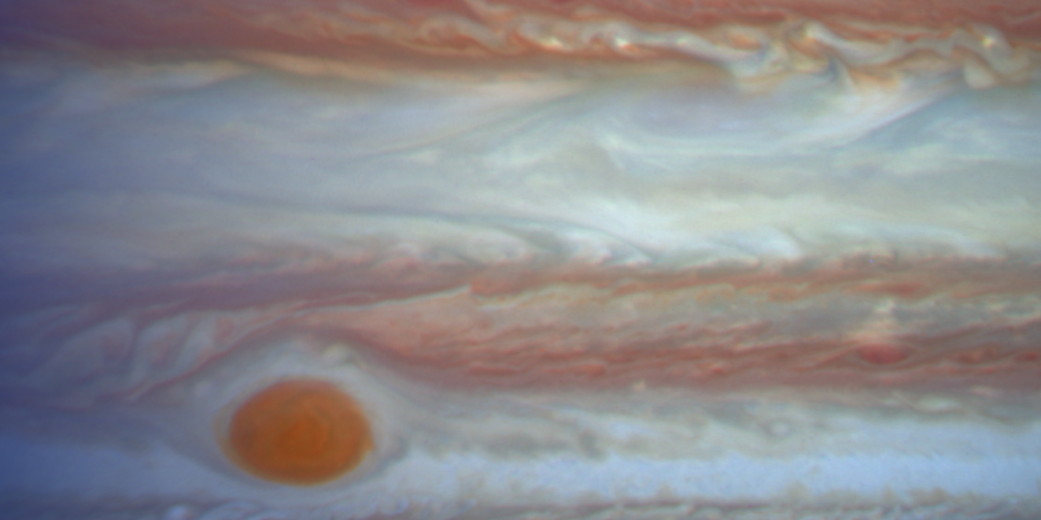
GRS, SEB, and NEDFs – HST vs Ground
Ammonia ~ T_{CH4}/T_{NH3}
NEB is NH₃ depleted
NH₃ enhancements extend northward ‘over’ NEDFs
GRS shows high clouds and low NH₃
SEB shows deep clouds with NH₃ depletion
STrZ shows higher clouds and enhanced NH₃
Cloud Press. ~ 1-T_{CH4}
673/502/395

Slide 4
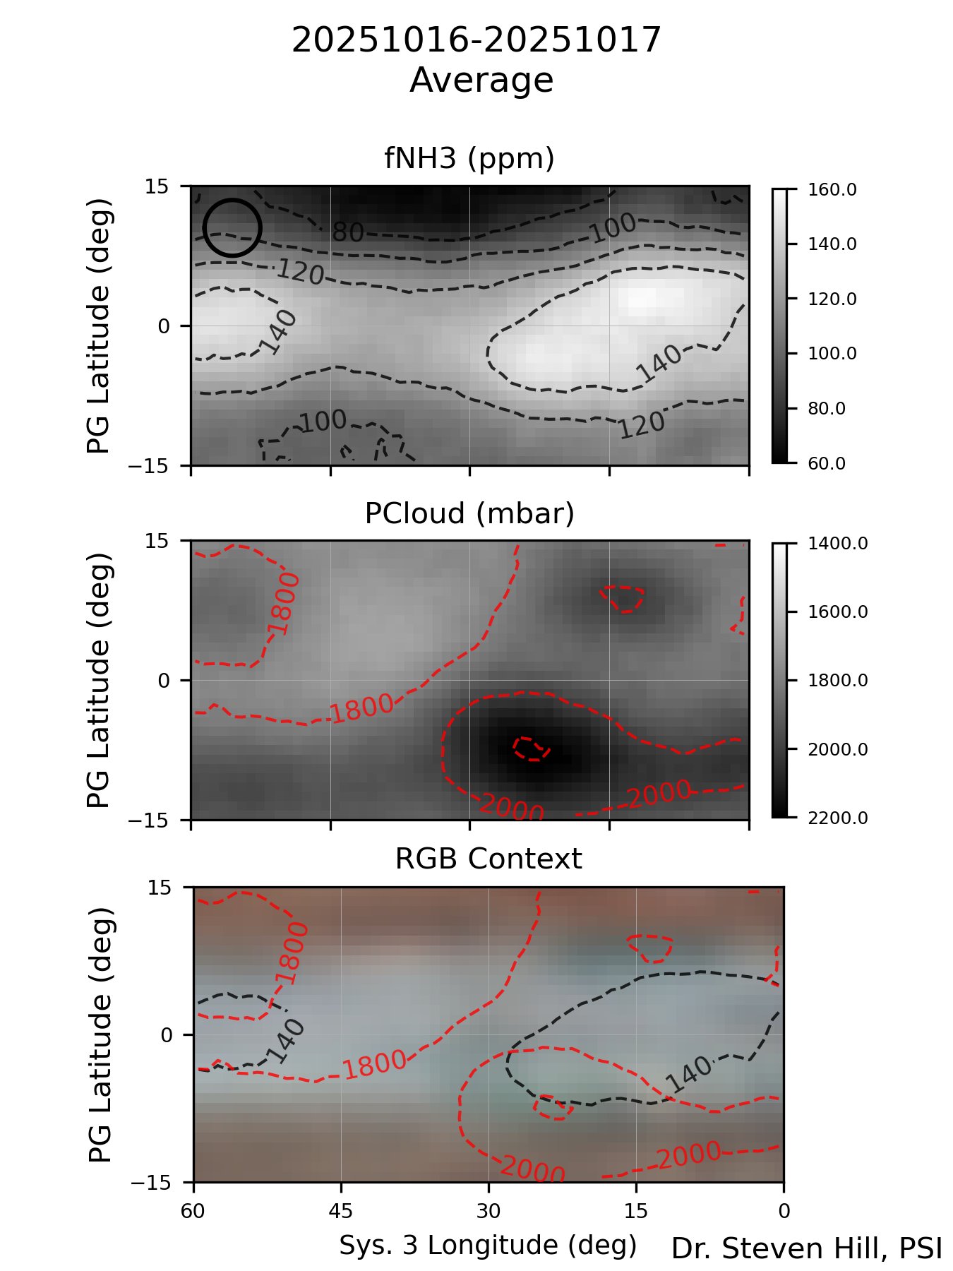
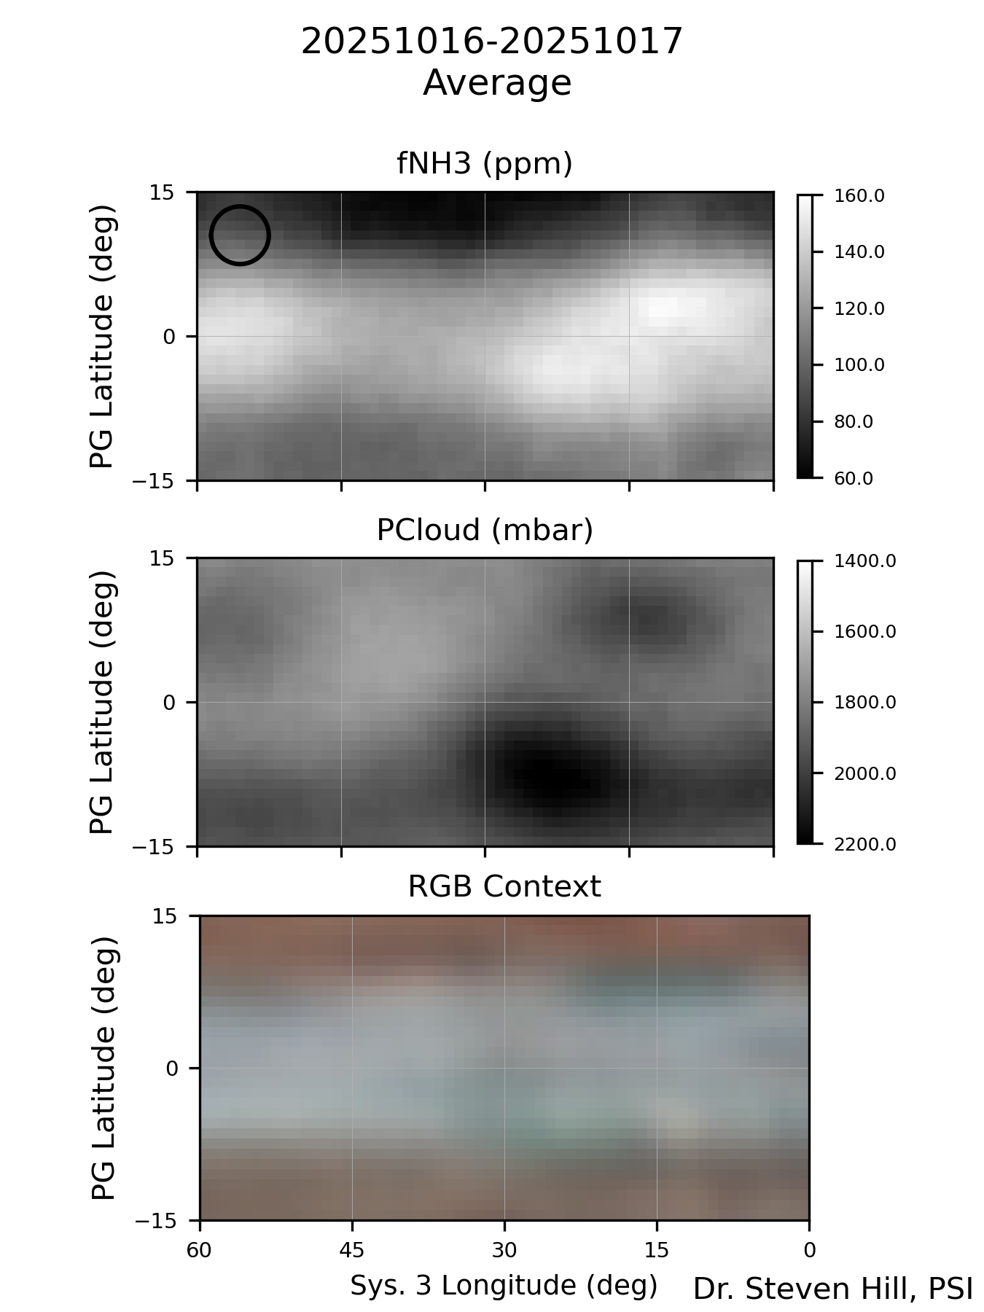
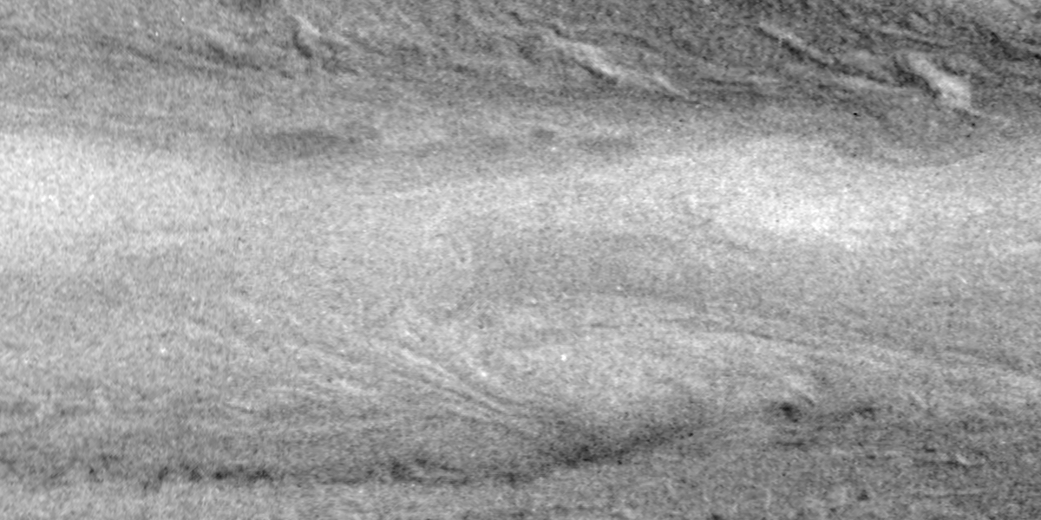
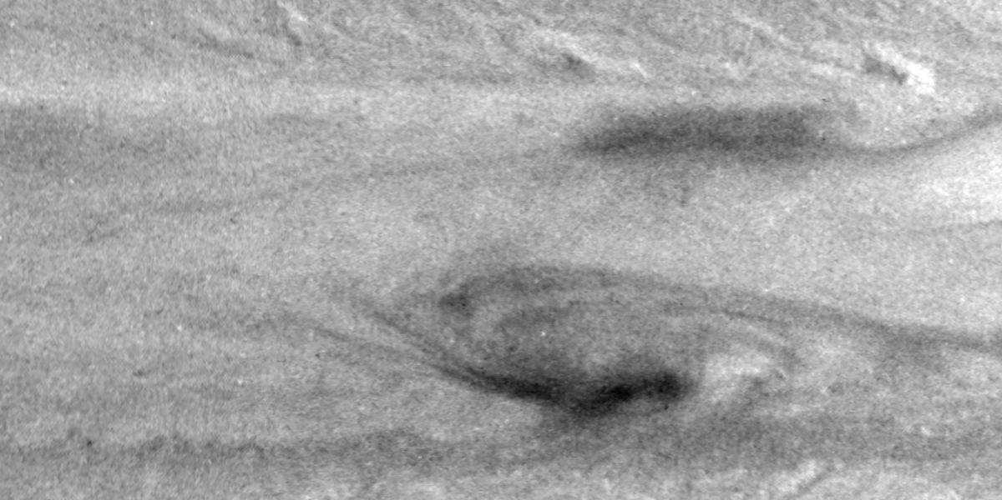
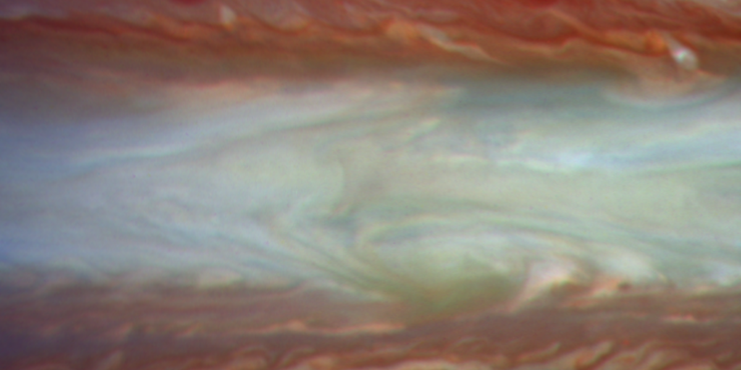
SED and NEDFs – HST vs Ground
Ammonia ~ T_{CH4}/T_{NH3}
NEB is NH₃ depleted
NH₃ enhancements extend northward ‘over’ NEDFs
SED shows very deep clouds, equatorward NH₃ enhancement
SED also shows a unique greenish tinge in context image
Cloud Press. ~ 1-T_{CH4}
673/502/395

Slide 5
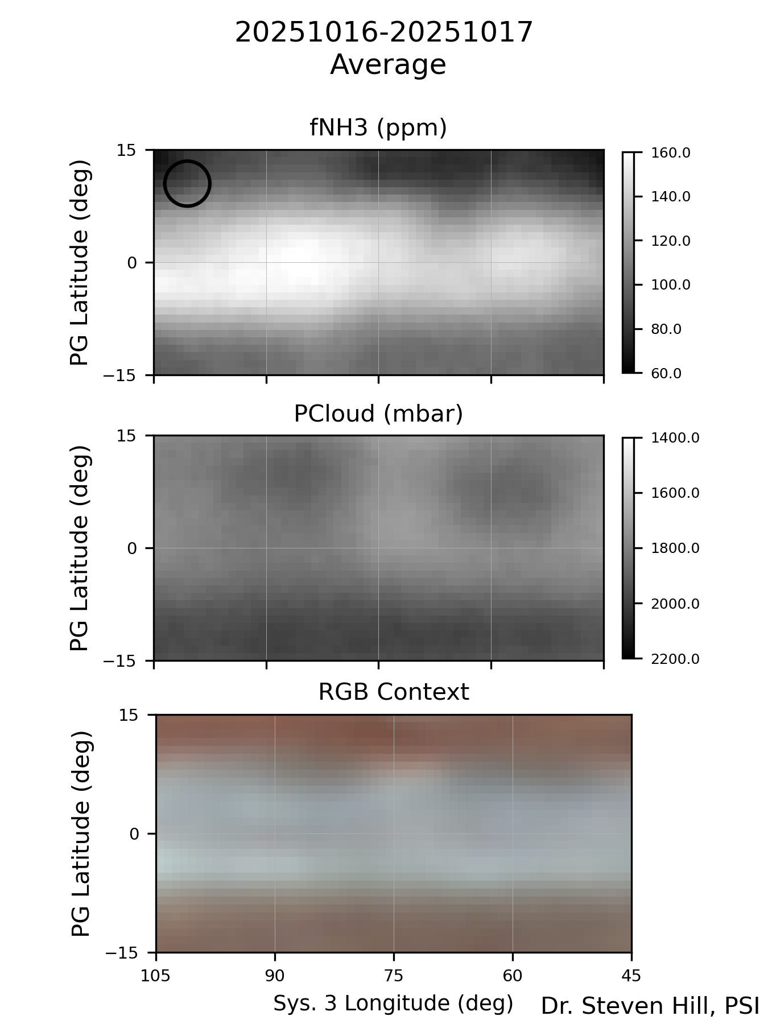
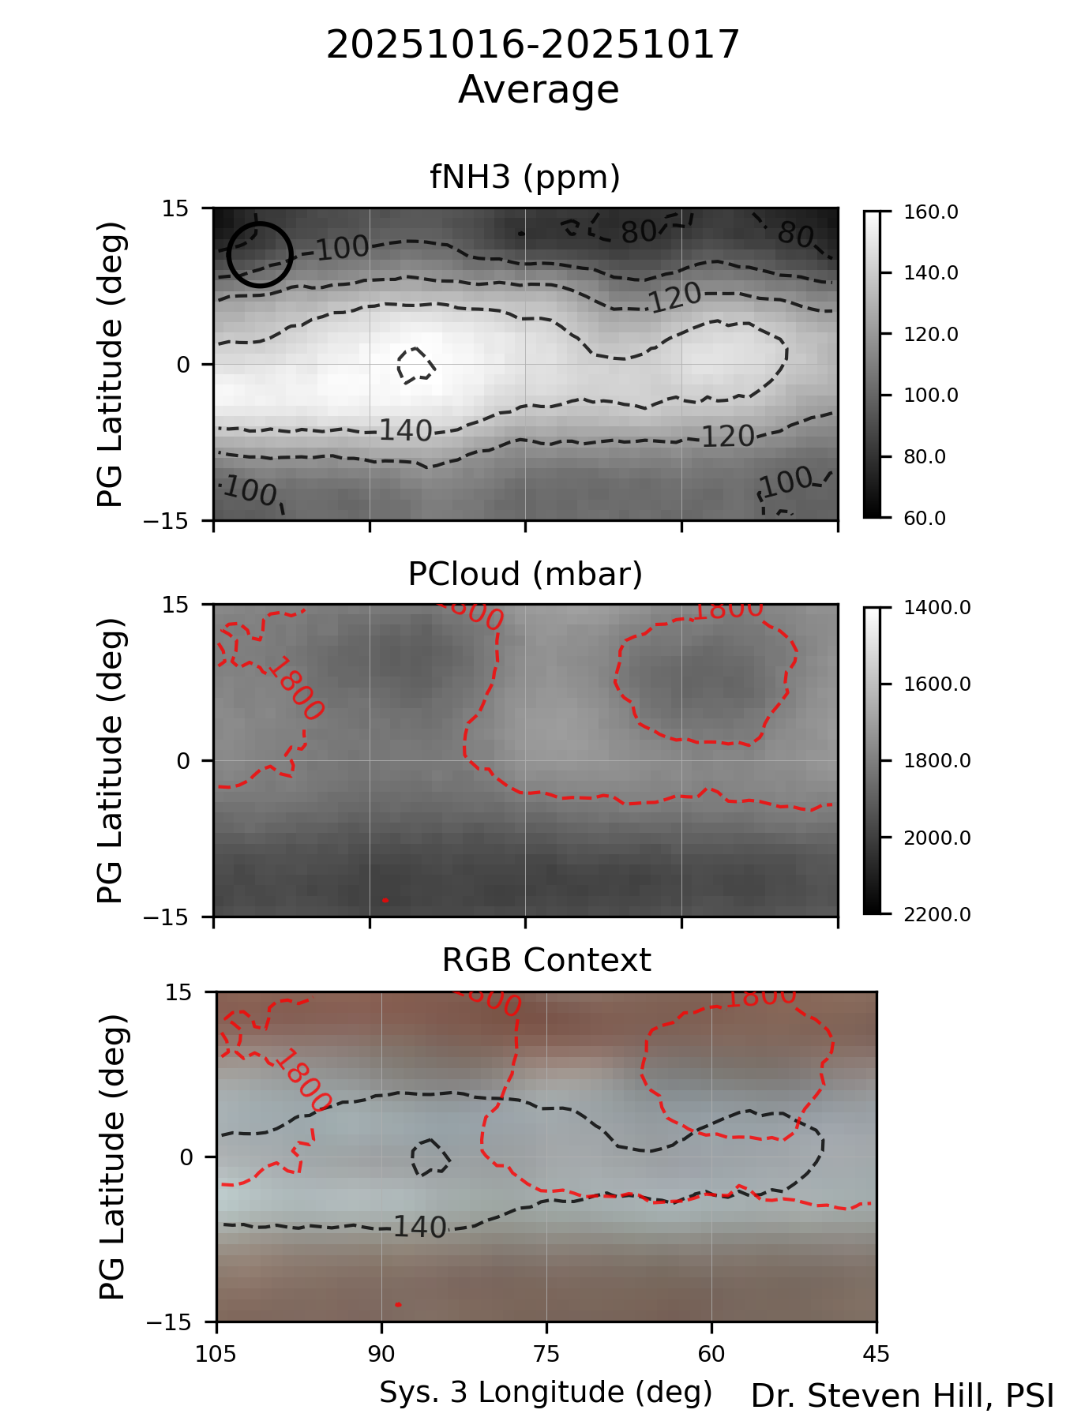
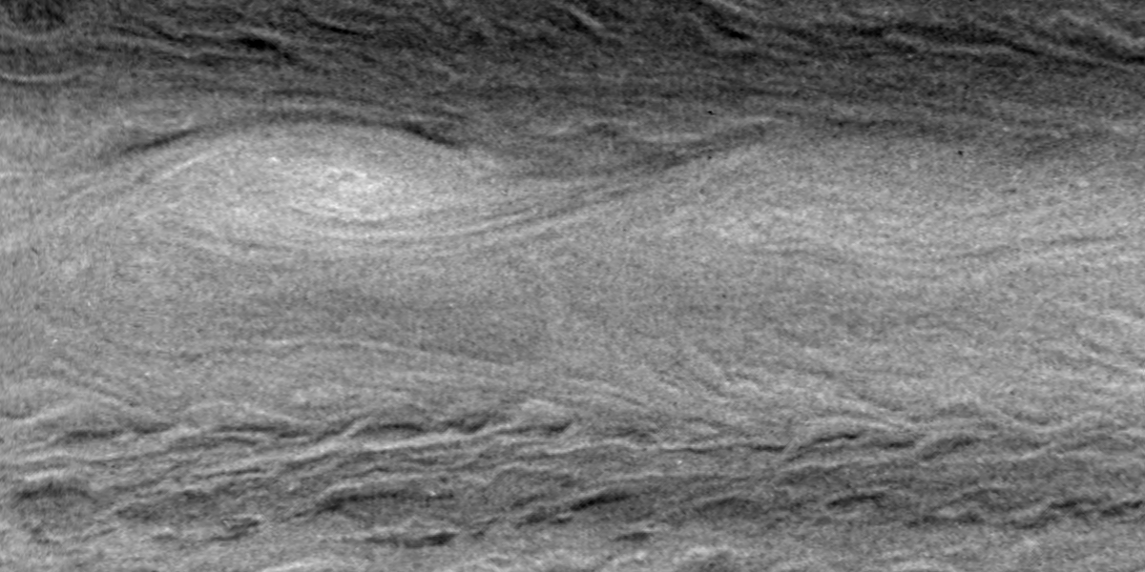
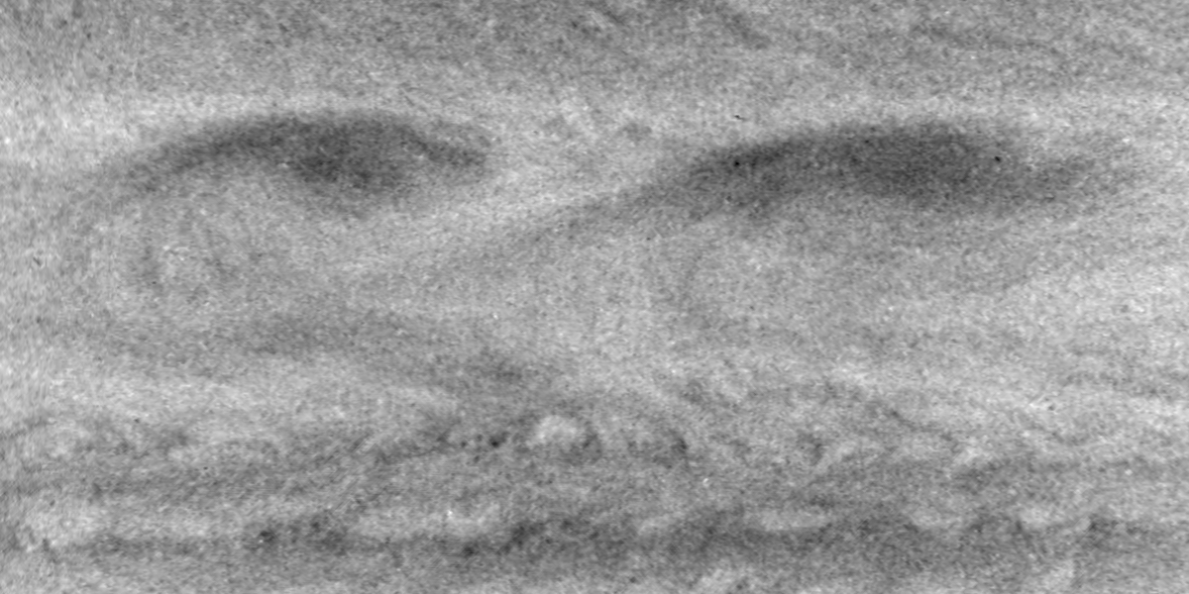
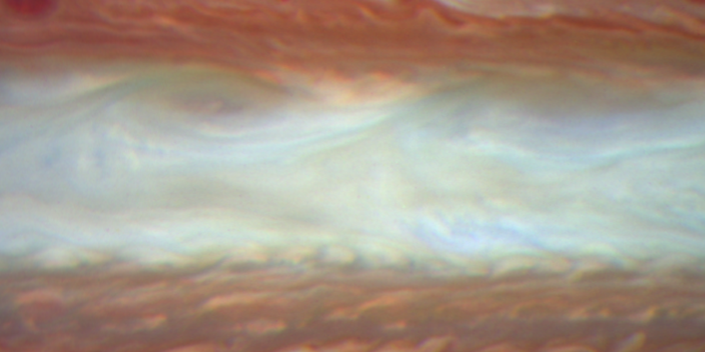
NEDFs – HST vs Ground
Ammonia ~ T_{CH4}/T_{NH3}
NEB is NH₃ depleted
NH₃ enhancements extend northward ‘over’ NEDFs
SEB shows very deep clouds and some NH₃ depletion
STrZ shows higher clouds and enhanced NH₃
Cloud Press. ~ 1-T_{CH4}
673/502/395

Slide 6
HST Close Ups of SED and NEDFs
SED
NEDF
NEDF
Ammonia ~ T_{CH4}/T_{NH3}
Cloud Press. ~ 1-T_{CH4}
NH₃ enhancement is equatorward of NEDFs , but overlaps NEDFs
Is the SED a wave number 1 Rossby Wave Feature?

Slide 7
Thoughts
NH₃ enhancements have centroids south of NEDFs seen in ground and HST data
HST data show the enhancements are spatially extended and that the extended nature seen in ground data is not due to poorer resolution
While the enhancements are extended, structured features with centers are south of the NEDFs, they also extend poleward and overlap the NEDFs
The SED looks like a north-south mirror version of NEDFs providing further support that the SED is the result of a Rossby wave with wave number = 1

